Slide 1
Loss Function
Instructor: Dr. Yan Yan

Slide 2
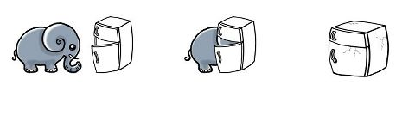
Three Steps for Deep Learning
Step 1:
define a set of function
Step 2:
goodness of function
Step 3:
pick the best function
Deep Learning is so simple ……
Neural
Network

Slide 3





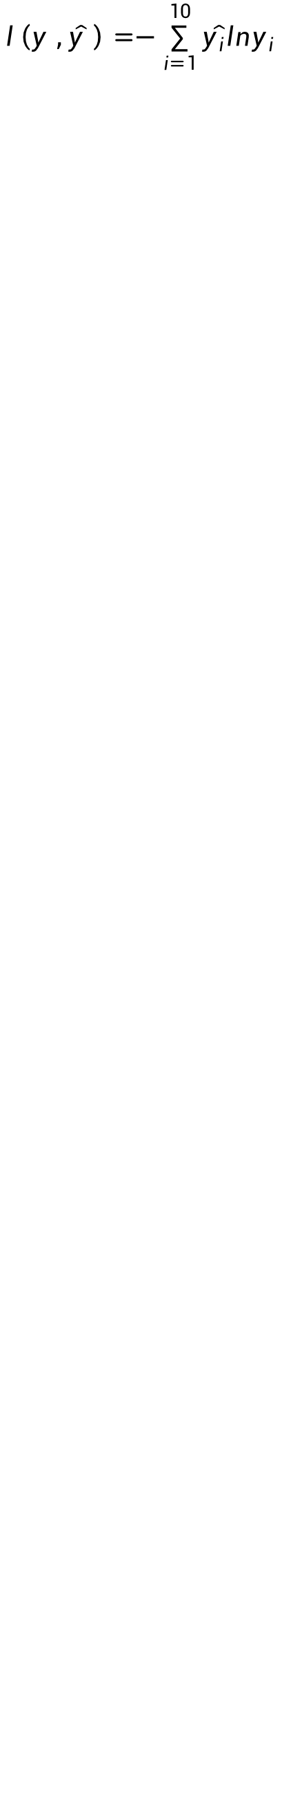

Loss for an Example
target
“1”
…
y₁
$${\hat{y}}_{1}$$
1
……
0
Given a set of parameters
y₂
$${\hat{y}}_{2}$$
Softmax
……
……
Cross
Entropy
…
…
…
…
…
y₁₀
0
$${\hat{y}}_{10}$$
$$y$$
$$\hat{y}$$
$$l\left(y ,\hat{y} \right)=−\sum_{i=1}^{10}{\hat{y_{i}}lny_{i}}$$

Slide 4





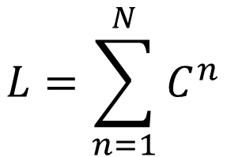










Total Loss
$$L=\sum_{n=1}^{N}{l^{n}}$$
For all training data …
Total Loss:
x¹
NN
y¹
$${\hat{y}}^{1}$$
$$l^{1}$$
Find a function in function set that minimizes total loss L
x²
NN
y²
$${\hat{y}}^{2}$$
$$l^{2}$$
x³
NN
y³
$${\hat{y}}^{3}$$
Find the network parameters $θ^{∗}$ that minimize total loss L
$$l^{3}$$
…
…
…
…
x^{N}
NN
y^{N}
$${\hat{y}}^{N}$$
$$l^{N}$$

Slide 5
Three Steps for Deep Learning
Step 1:
define a set of function
Step 2:
goodness of function
Step 3:
pick the best function
Deep Learning is so simple ……
Neural
Network

Slide 6




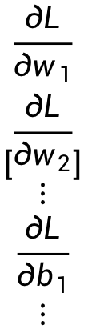







Gradient Descent
$$θ$$
Compute ${∂L}/{∂w_{1}}$
$$\left[\begin{aligned}\frac{∂L}{∂w_{1}} \\ \frac{∂L}{∂w_{2}} \\ ⋮ \\ \frac{∂L}{∂b_{1}} \\ ⋮\end{aligned}\right]$$
$$w_{1}$$
0.2
0.15
$$−μ{∂L}/{∂w_{1}}$$
Compute ${∂L}/{∂w_{2}}$
$$w_{2}$$
-0.1
0.05
$$∇L=$$
$$−μ{∂L}/{∂w_{2}}$$
…
Compute ${∂L}/{∂b_{1}}$
$$b_{1}$$
0.3
0.2
$$−μ{∂L}/{∂b_{1}}$$
gradient
…

Slide 7
Gradient Descent
$$θ$$
Compute ${∂L}/{∂w_{1}}$
Compute ${∂L}/{∂w_{1}}$
$$w_{1}$$
0.2
0.15
0.09
$$−μ{∂L}/{∂w_{1}}$$
$$−μ{∂L}/{∂w_{1}}$$
…
Compute ${∂L}/{∂w_{2}}$
Compute ${∂L}/{∂w_{2}}$
$$w_{2}$$
-0.1
0.05
0.15
$$−μ{∂L}/{∂w_{2}}$$
$$−μ{∂L}/{∂w_{2}}$$
…
…
Compute ${∂L}/{∂b_{1}}$
Compute ${∂L}/{∂b_{1}}$
$$b_{1}$$
0.3
0.2
0.10
$$−μ{∂L}/{∂b_{1}}$$
$$−μ{∂L}/{∂b_{1}}$$
…
…

Slide 8

Gradient Descent
This is the “learning” of machines in deep learning ……
Even alpha go using this approach.
I hope you are not too disappointed :p

Slide 9






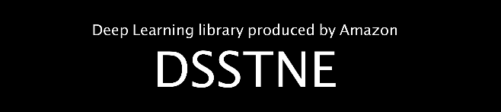


Backpropagation
Backpropagation: an efficient way to compute ${∂L}/{∂w}$ in neural network

